Slide 1
32-bit Single Precision Floating Point Adder
VHDL

Slide 2
TABLE OF CONTENTS
01
05
How does it work?
Introduction
02
06
Applications
Problem Definition
03
07
What I am Working On
Results
08
Conclusion
04
Core Block Diagram

Slide 3
Introduction
FPGA
-In a modern society, monitoring and controlling the environment is becoming increasingly important. So, We need to implement a floating point unit in our design for measurement accuracy.
-Not all devices have a dedicated FPU. Many midrange computers or microcontrollers execute floating-point operations through software libraries, but in others, such as High-Performance systems or graphics cards, an FPU is often essential to carry out complex calculations quickly and accurately
This project presents an FPGA-based 32-bit Floating Point Adder is
designed in VHDL.
Like, medical devices.

Slide 4
Problem Definition
Flexibility
Software has limited flexibility
Customization
It hard to customize the edge detection algorithm to match the specific requirements of the application
Efficiency
It requires high power consumption to run FPU on a general-purpose CPU
& Performance Speed
The software has limited capability of processing large amounts of data at high speeds, making them unsuitable for real-time applications.

Slide 5
What I am Working On
FPGA
ModelSim
Xilinx platform studio

Slide 6
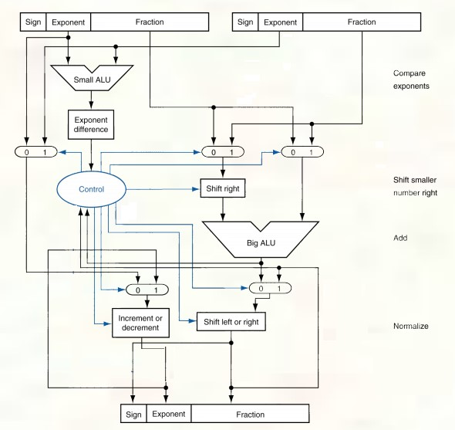
Core Block Diagram

Slide 7
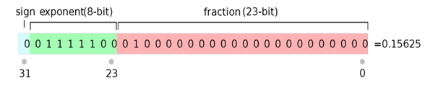
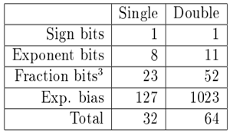
How does it work?
The project uses the IEEE-754 Single Precision floating point format. The following table lists how the 32-bit floating number is divided into 3 parts. Mantissa, Exponent and the Sign bit.

Slide 8

Applications
1- Fingerprint
3- Robotics vision (self-driving vehicles)
Set the steering wheel angle based on a picture of the road.
FPU enhance the quality of images and cause improvement in the image recognition
2- Satellite Image
4- Medical devices
The filter used produces a more accurate and a well-localized edge map
high accuracy glucose monitoring device image

Slide 9
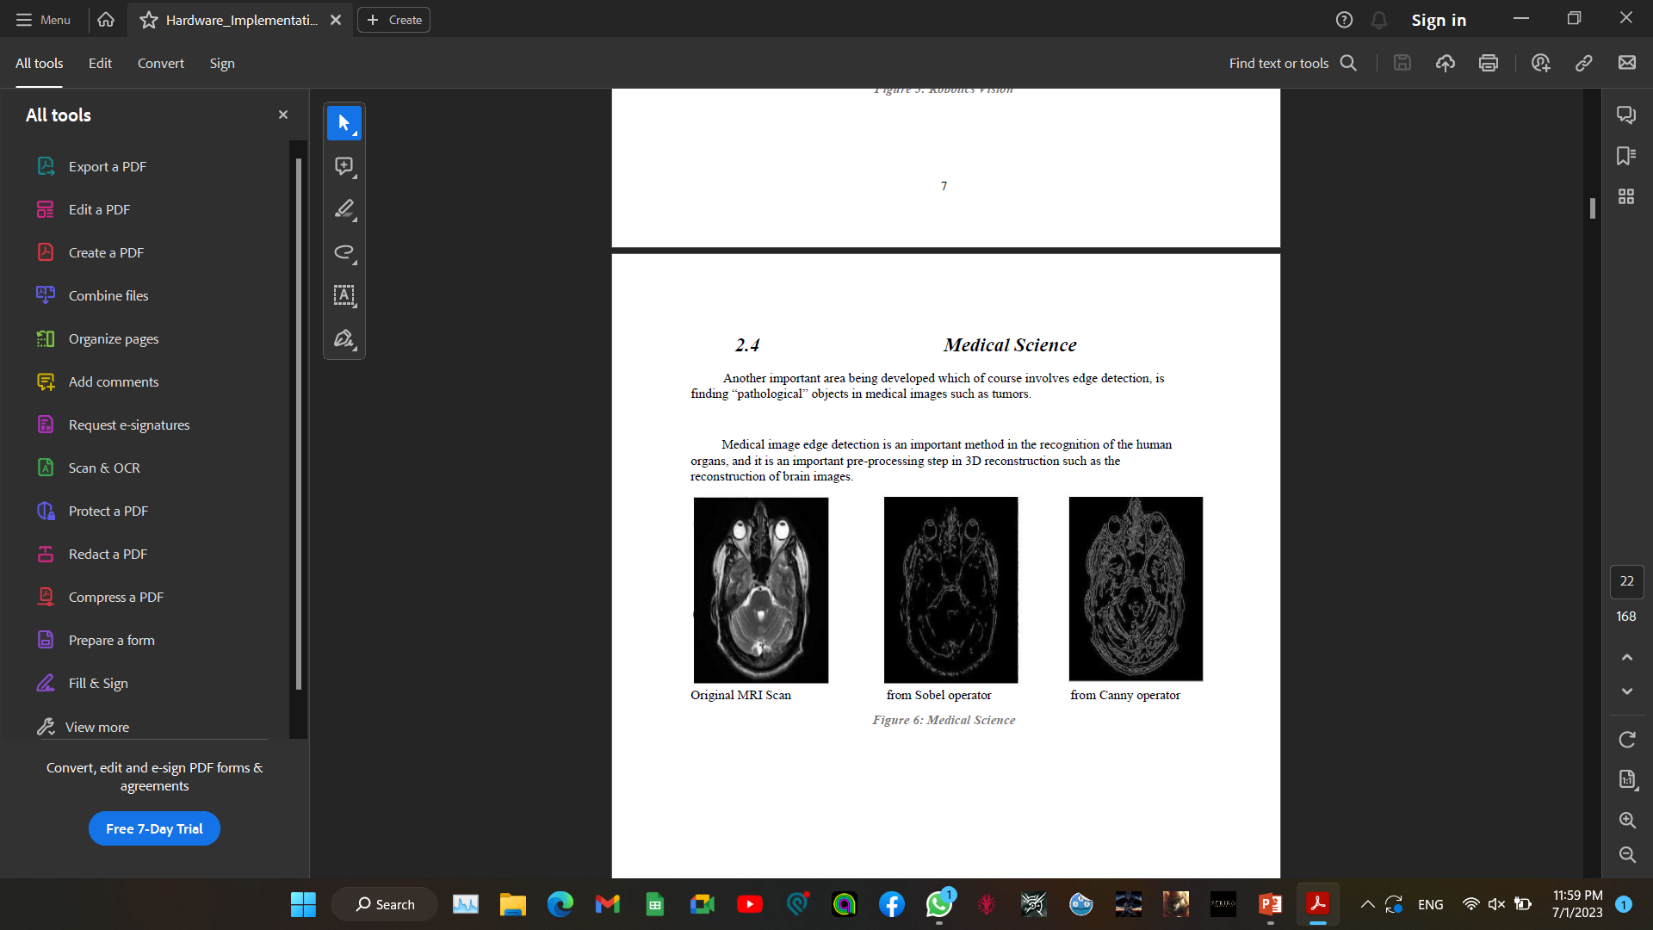
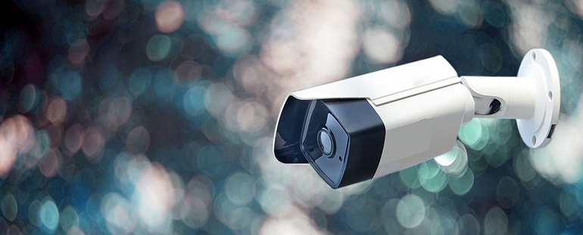
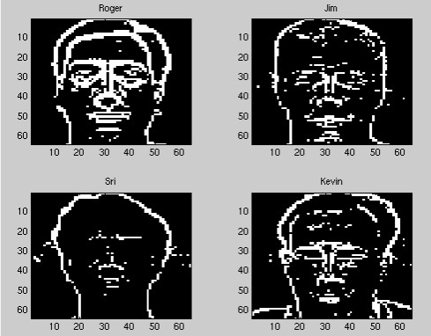
Applications
4- Medical Science
6- CVVT Camera
Medical image edge detection is an important method in the recognition of the human organs, and it is an important pre-processing step in 3D reconstruction such as the reconstruction of brain images
5- Face recognition

Slide 10
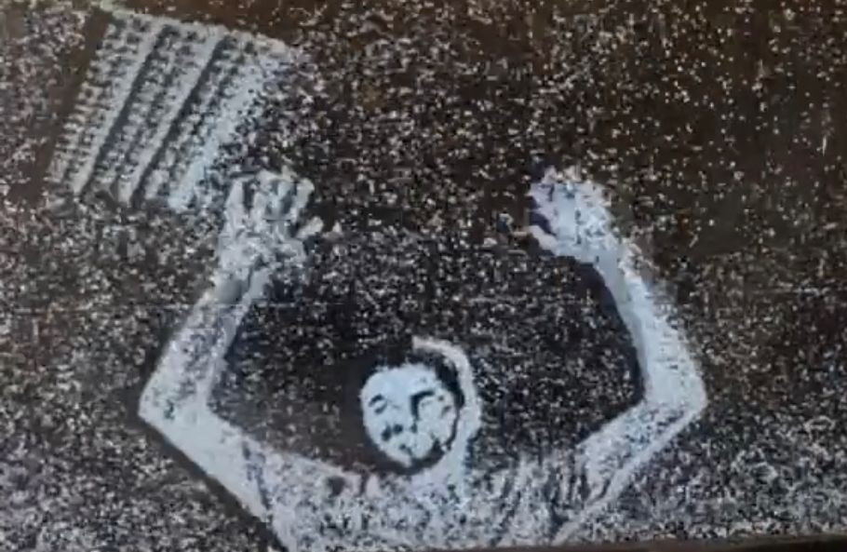
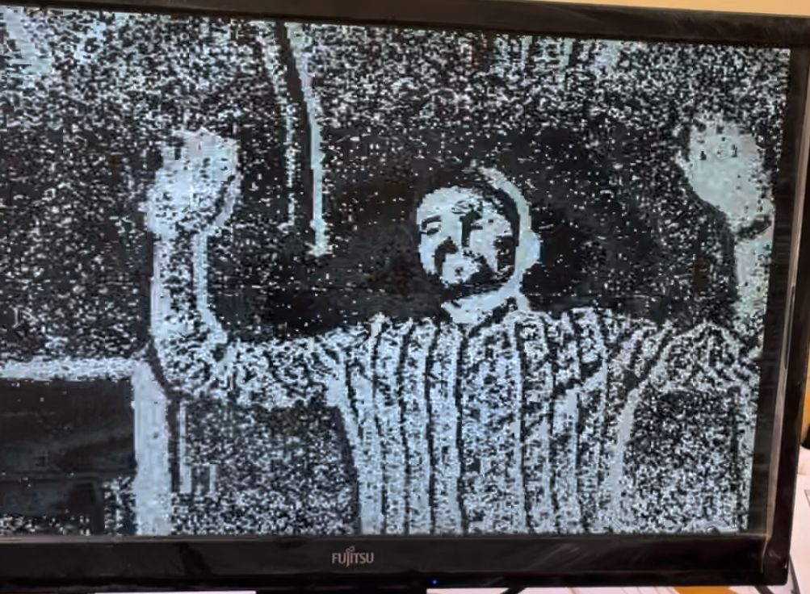
Results

Slide 11
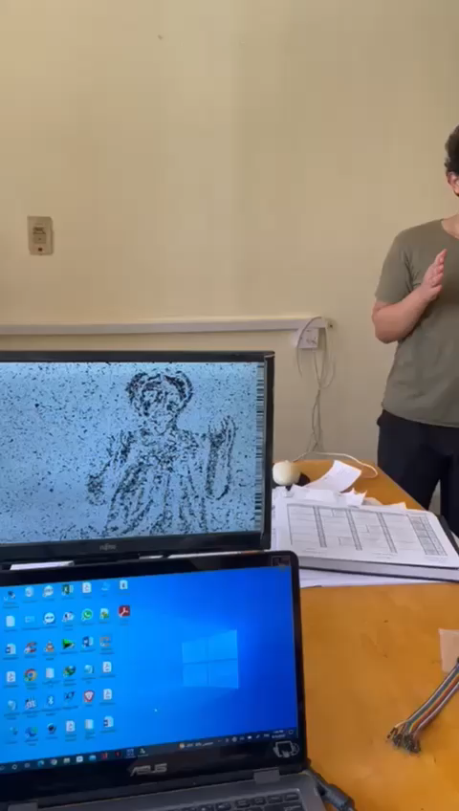
Results (Edge Detection)

Slide 12
Conclusion
This project was implemented using Verilog HDL and it was implemented successfully.
Sobel Filter is used as it is simple, more time-efficient, requires low computation and detects edges and their orientation.
The advantages of FPGA-based edge detection over software-based edge detection are as follows:
Speed & Performance: This is particularly important for real-time applications, such as robotics or autonomous vehicles.
Efficiency: FPGAs are highly optimized for specific tasks and can be programmed to perform only the required operations for edge detection, resulting in much lower power consumption.
Customization: FPGAs are highly configurable, which means that they can be customized to meet the specific needs of a particular application.
Flexibility: FPGA allows for flexibility in implementing different edge detection algorithms.
More work is needed regarding the accuracy

Slide 13


